Slide 1
Ecphrastic poetry & the development of professional literacy in geography

Slide 2
What is ecphrastic poetry?
Ecphrastic poetry is the conversation between two pieces of art. The writer interprets a work of visual art and then creates a narrative in verse form that represents his or her reaction to that painting, photograph, sculpture or other artistic creation.
http://www.firkinfiction.com/11.html

Slide 3
Ecphrastic poetry and geography
How do you write a geography-related poem in an ecphrastic manner?
Complete the following steps:
  View a stimulus image and identify a geography-related concept it evokes.
  If required, write down the concept, definition, law, formula etc.
  Identify a suitable poetry type and write the poem.

Slide 4

What concept does this image evoke?
http://pull.imgfave.netdna-cdn.com/image_cache/1311020186941207.jpg

Slide 5
Countries of the world

Slide 6
Example Haiku poem
Yugoslavia
Is no longer a country
But Yemen still is
http://www.jokes2go.com/poems/7881.html?6

Slide 7
Example Acrostic poem
Islands of Sicily and Sardinia are in its territory
Towering over Naples is Mount Vesuvius
Austria, France, Switzerland and Slovenia are its neighbours
Located in southern Europe
You can visit Rome, Florence and Venice

Slide 8
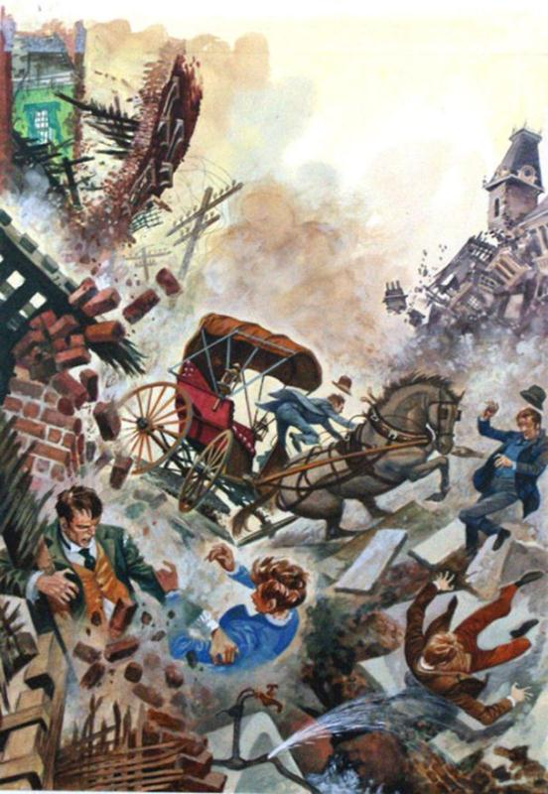
What concept does this image evoke?
http://www.bookpalace.com/acatalog/JacksonPDisasterLL.jpg

Slide 9
Natural Disasters

Slide 10
Example Limerick poem
Hurricanes muss up your hair
Tornados scatter cookware
Floods chase you higher
Volcanos spit fire
Earthquakes don't really compare
http://www.facebook.com/topic.php?uid=32467752245&topic=7477

Slide 11
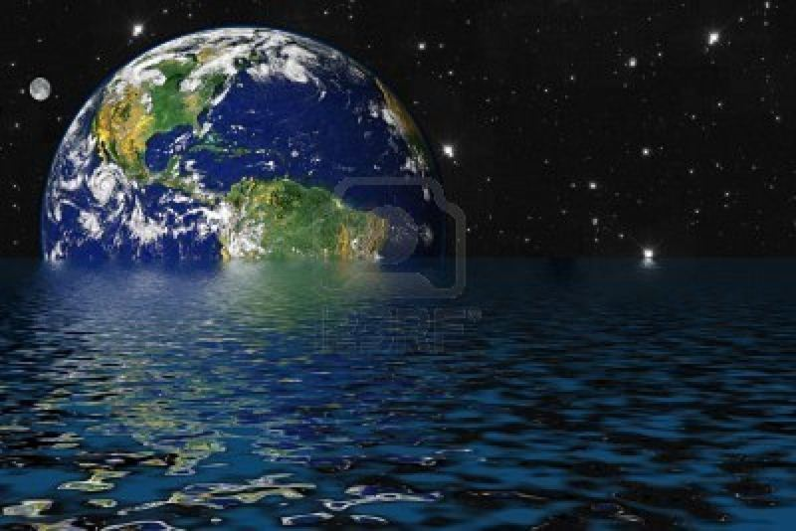
What concept does this image evoke?
http://us.123rf.com/400wm/400/400/joseelias/joseelias0706/joseelias070600015/999709-drowning-earth-due-to-global-warming-and-greenhouse-effect.jpg

Slide 12
The Greenhouse Effect causes the polar caps to melt resulting in a rise in the sea levels

Slide 13
Example Free Verse poem
Everyday our earth gets warmer,
Soon it’ll be like living in one big sauna.
Ice caps are melting and sea levels are beginning to rise,
So why won’t people grow up and be wise?
Atmospheric gases are building up quickly,
All because we pollute so thickly.
We make money by burning fossil fuels and oil
But it’s our world we’re going to spoil!
http://www.sln.org.uk/geography/pop/environment/Environment.htm

Slide 14
Example Free Verse poem
There’s been a 20% increase in the last century,
And a 40% increase in this one eventually.
I think this is unnaturally hurried
But most people aren’t even worried!
Carbon dioxide, nitrous oxide and methane,
Wrecked crops and acid rain.
The list of disadvantages never ends
And if our earth survives, on us it depends
http://www.sln.org.uk/geography/pop/environment/Environment.htm

Slide 15
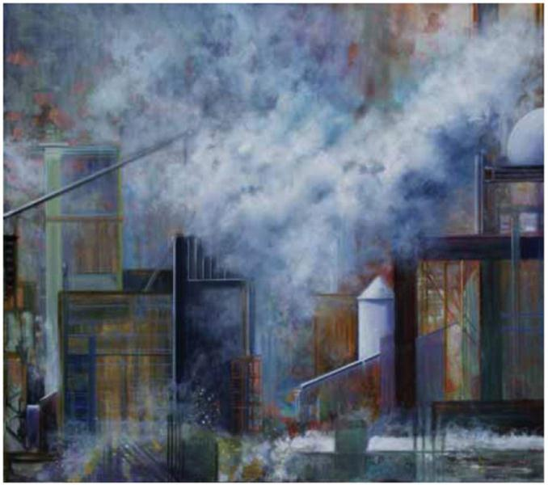
What concept does this image evoke?
http://www.issues.org/24.2/images/archive.jpg

Slide 16
Pollution

Slide 17

Example Concrete poem
http://imtiredofthisblackandblue.files.wordpress.com/2011/03/pollutionnn.jpg

Slide 18
Example Cinquain poem
pollution
poisonous, lethal
damage, destroy, demolish
no thought for life
contaminate
http://www.peap.info/pollution-criteria/3022/does-this-meet-the-criteria-for-the-parts-of-speech-style-cinquain.html

Slide 19
What concept does this musical composition evoke?
Jingle Bells

Slide 20
Latitude and longitude

Slide 21
Example re-worked song lyric
Latitude, latitude, lines go round and round.
Measuring north, measuring south, from the equator.
Latitude, latitude, lines go round and round.
Measuring north, measuring south,
those lines of latitude.
http://www.proteacher.org/c/326_latitude_and_longitude.html

Slide 22
Example re-worked song lyric
Longitude, longitude, lines go up and down.
Measuring east, measuring west,
from the prime meridian.
Longitude, longitude, lines go up and down.
Measuring east, measuring west,
those lines of longitude.
http://www.proteacher.org/c/326_latitude_and_longitude.html

Slide 23
Activity
Using the given stimulus material, create the following types of poetry:
Free verse
Acrostic
Cinquain
Haiku
Limerick

Slide 24
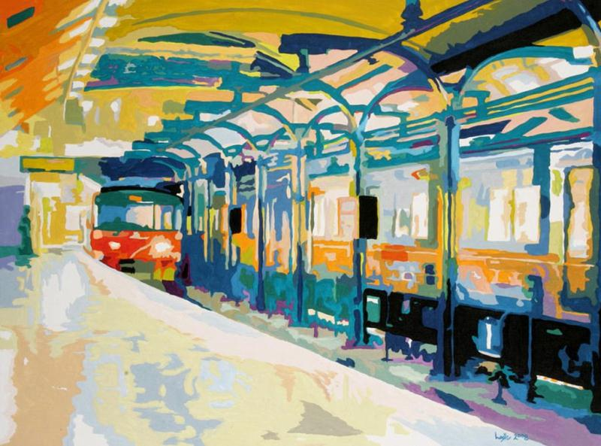
STIMULUS IMAGE 1
http://images.fineartamerica.com/images-medium-large/underground-bobby-logic.jpg

Slide 25

STIMULUS IMAGE 2
http://richardcardona.com/uploaded_images/population-726775.jpg

Slide 26
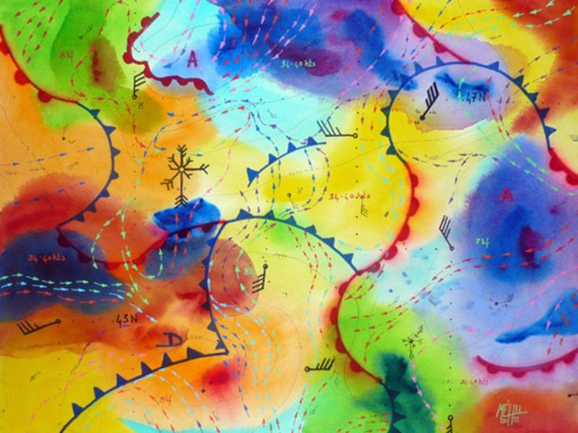
STIMULUS IMAGE 3
http://behance.vo.llnwd.net/profiles21/283126/projects/878227/628e7ddd47638825f42d91700458fb79.jpg

Slide 27

STIMULUS IMAGE 4
http://www.anniekaills.com/art/lavallee/eskimo_snow2.jpg

Slide 28
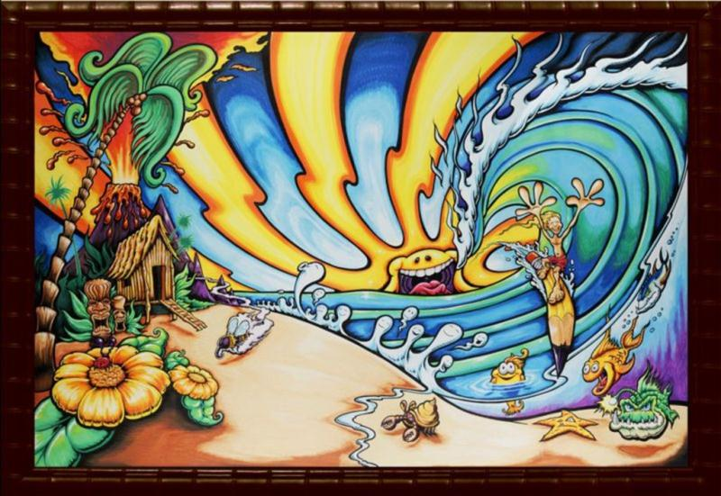
STIMULUS IMAGE 5
http://drewbrophy.com/site/wp-content/uploads/2010/03/walters-wave-painting-by-drew-brophy-mixed-media-on-wood-48-x-72-2009-rs.jpg

